Slide 1
ASSESSING THE IMPACT OF DUMPSITE LEACHATE ON GROUNDWATER CONTAMINATION in N GHANA: Geophysical, STATISTICAL, AND MACHINE LEARNING APPROACH
Data Science & Machine Learning Project
Spring 2025
Emmanuel Nyavor
Department of Geological Sciences, University of Florida

Slide 2
Rapid population growth & urbanization in N- Ghana
Increase waste generation
NEDs
Cheapest & fastest way of waste disposal
Environmental effects
Release of toxic substances causing groundwater contamination
Health implications
Leachate from waste dumps include heavy metals (Beinabaj et al., 2023; Carvajal-Flórez & Cardona-Gallo, 2019).

Slide 3
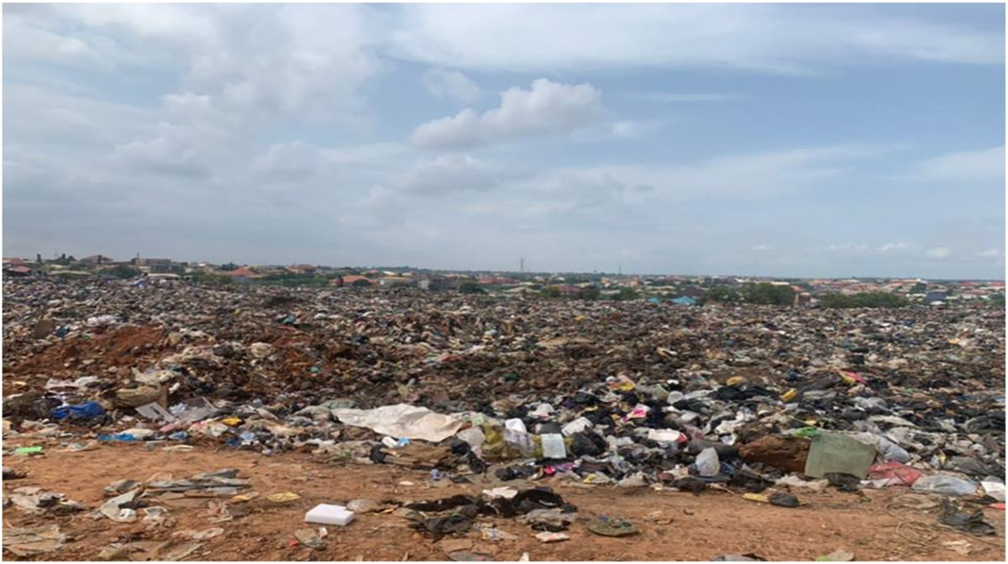
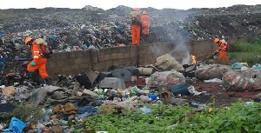
Kumasi
Accra

Slide 4
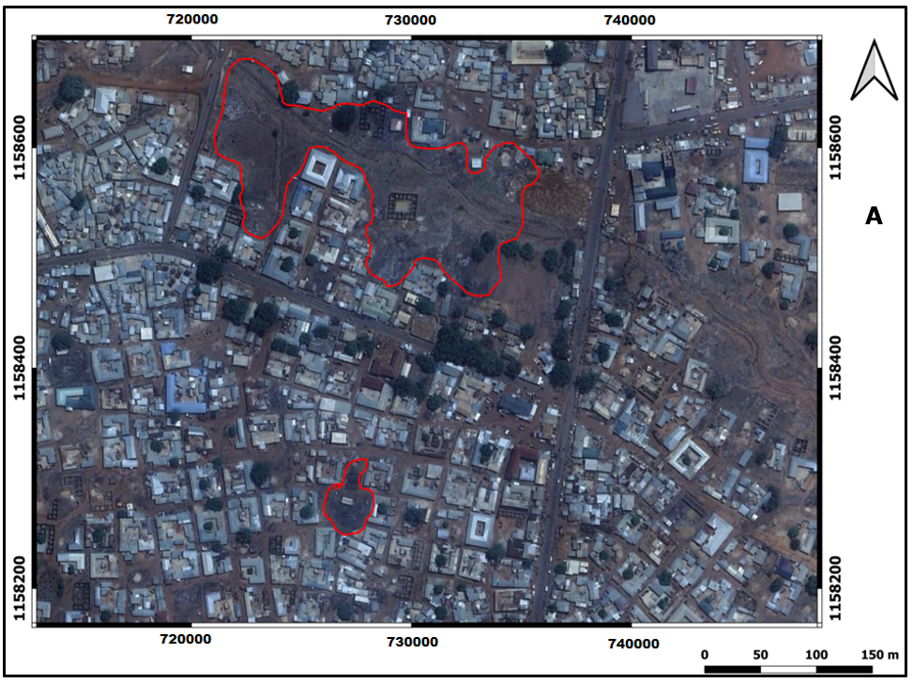
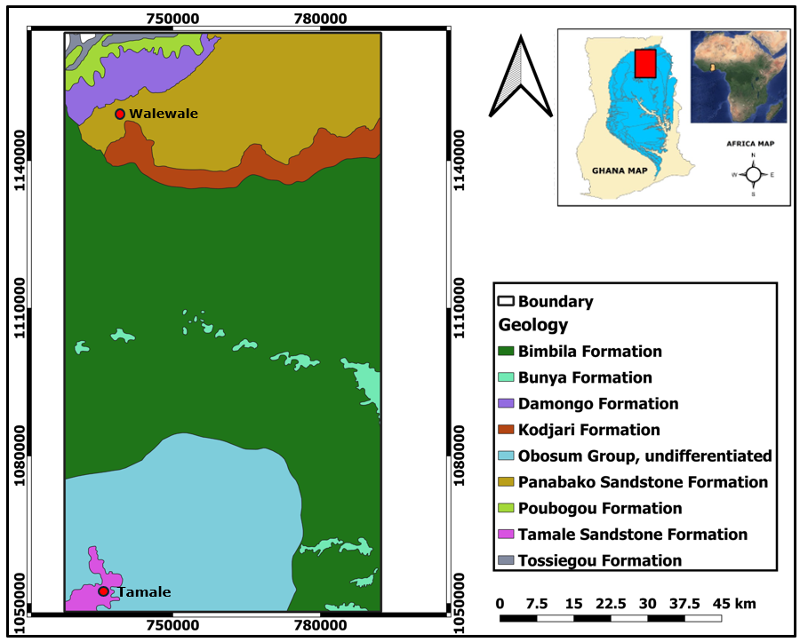
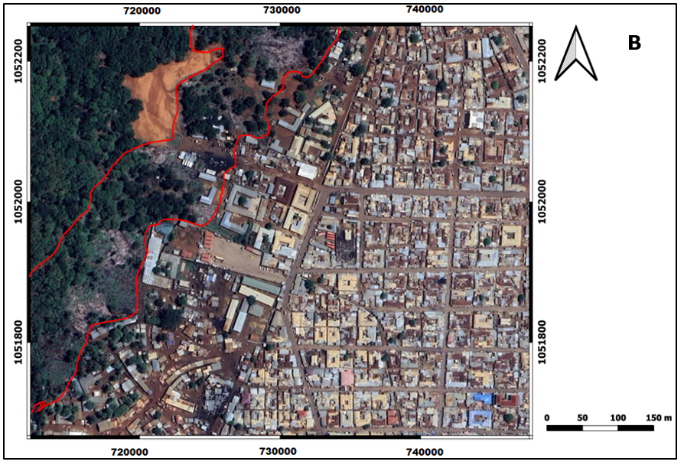

Slide 5
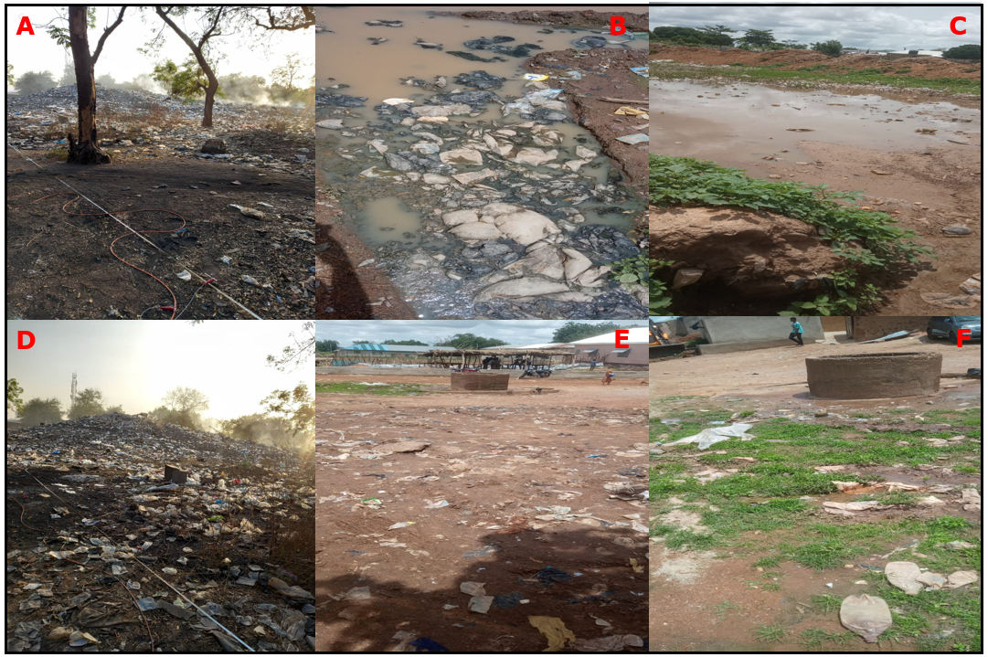
A
B
Walewale
Tamale

Slide 6
This project analyzes groundwater samples near non-engineered refuse dumpsites using PCA and machine learning to identify contamination patterns and sources.
Objectives & Methods
GW contamination patterns & Source
14
GW Samples
AAS
ECOLAB, Ghana
(HMC, TDS, Cl)
Assess leachate flow
(low-resistivity zones )
ERT
PCA
RF
SVM
K-MEANS
RES2DINVx64 (Geotomo-Software, 2002)

Slide 7
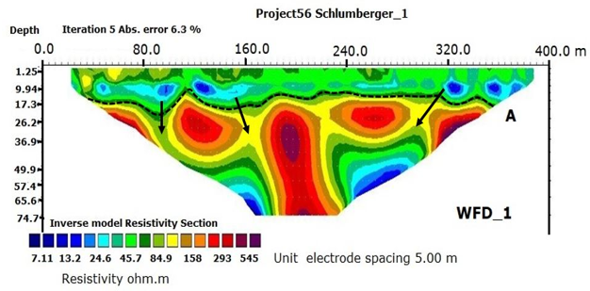
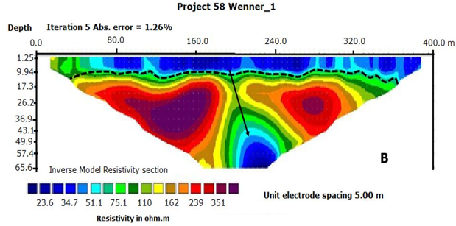
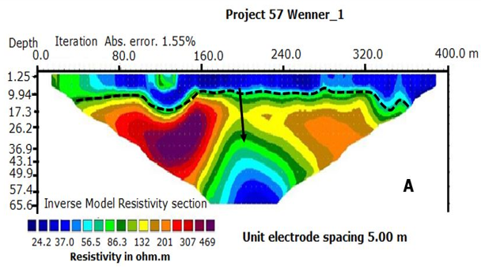
B
Low resistivity zones represent leachate flow paths (black arrows)
C

Slide 8
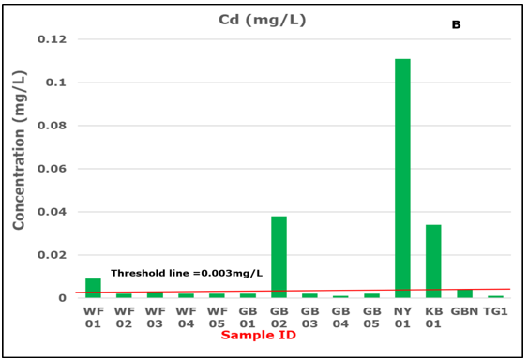
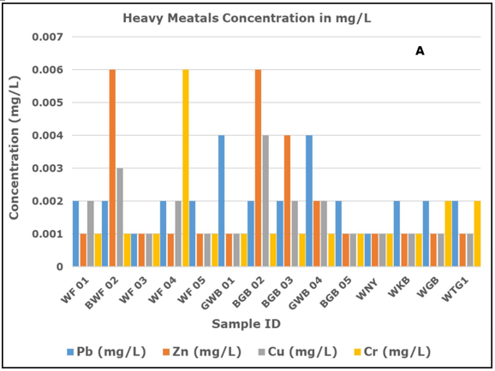
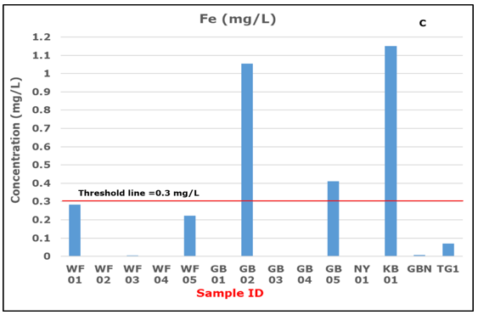
Heavy Metal Concentrations mg/L
WHO standards: Fe = 0.3 mg/L Cd = 0.003 mg/L
WHO(2022)

Slide 9
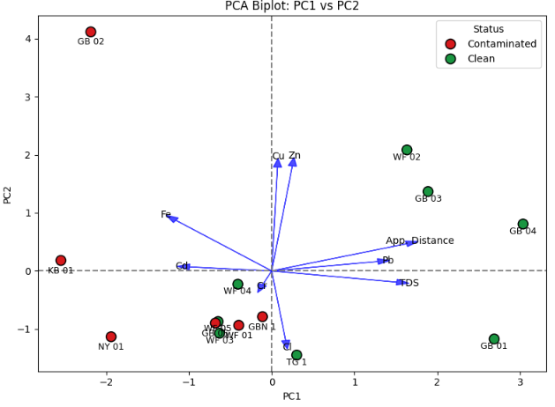
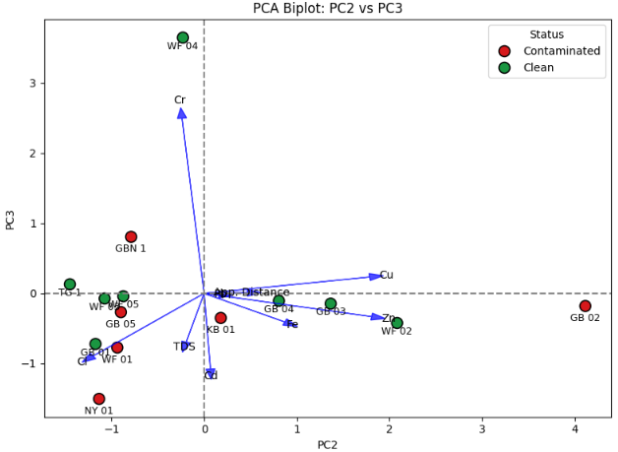
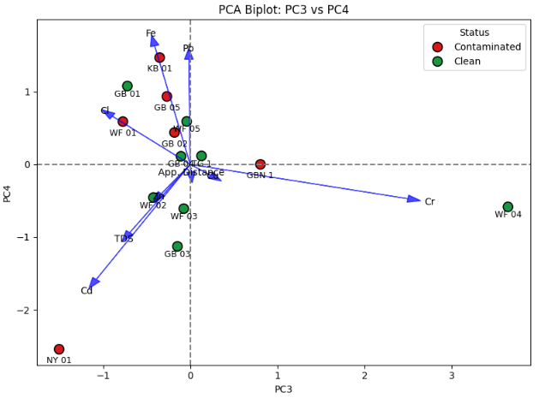
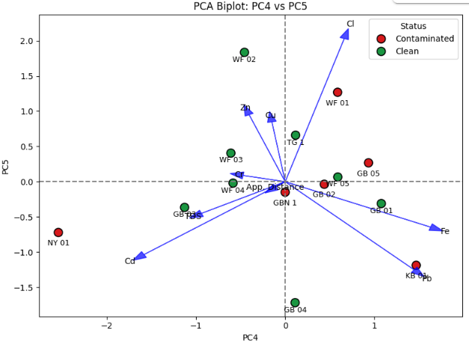
PRINCIPAL COMPONENT ANALYSIS

Slide 10
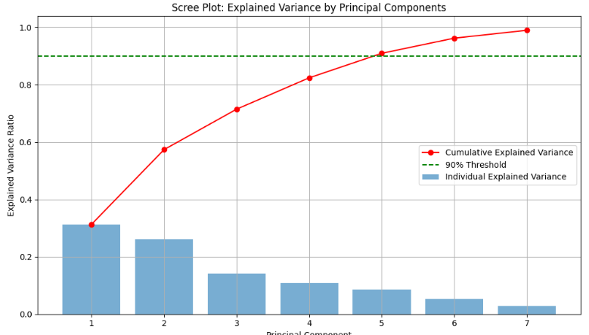

Slide 11
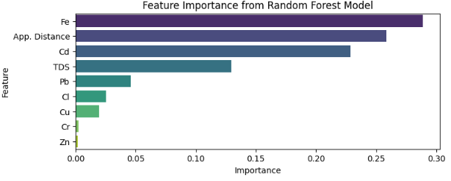
SUPERVISED LEARNING
RF model
Accuracy: 0.67
Most important variables for GW contamination are Fe, App. Distance, Cd
Also TDS and Pb
SVM model Accuracy: 0.67
Both RF and SVM have similar accuracies and may be equally good in predicting groundwater contamination

Slide 12
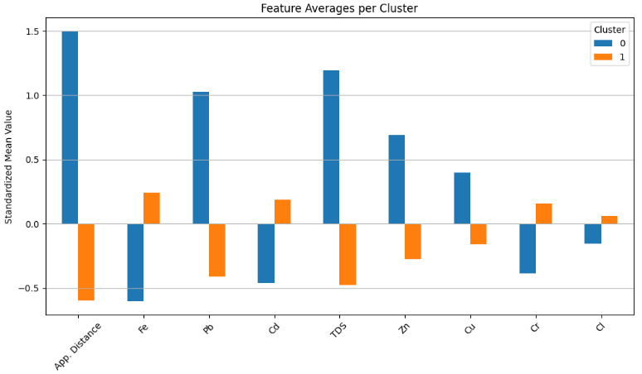
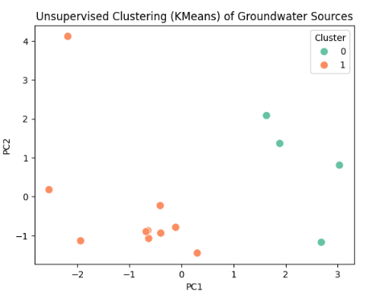
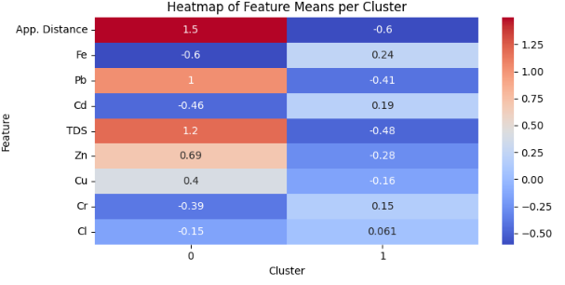
Unsupervised Learning
Most important variables for GW contamination are Fe, App. Distance, Cd
Also TDS and Pb

Slide 13
DISCUSSION AND CONCLUSION
PCA, RF, K-Means Clustering indicate at least proximity of GW sources to dumpsite as a major feature influencing GW contamination. Those sources closer to NEDs are more contaminated than those far away.
Low resistivity zones in the subsurface represent migration paths for transport of leachate from the NEDs to the water sources
Leachate from dumpsites contains several heavy metals including Cd and Fe which when infiltrated into the groundwater system, could increase their concentrations. According to the WHO (2022) report, the main source of Cd in drinking water is wastewater (e.g. leachate) released into the environment. Cd is widely used in the steel and plastics industries (Luparello et al., 2011).

Slide 14
Long-term consumption of Cd leads to accumulation in the kidneys, causing kidney disease and fragile bones (Genchi et al., 2020).
High concentration of Fe in water leads to overload (Adams, 2005; Taher & Saliba, 2017) which can cause diabetes, hemochromatosis, stomach problems, and nausea (Hossain et al., 2023).

Slide 15
References
Genchi, G., Sinicropi, M. S., Lauria, G., Carocci, A., & Catalano, A. (2020). The Effects of Cadmium Toxicity. International Journal of Environmental Research and Public Health, 17(11), 3782. https://doi.org/10.3390/ijerph17113782
Luparello, C., Sirchia, R., & Longo, A. (2011). Cadmium as a transcriptional modulator in human cells. Critical Reviews in Toxicology, 41(1), 75–82. https://doi.org/10.3109/10408444.2010.529104
Hossain, M. A., Haque, M. I., Parvin, M. A., & Islam, M. N. (2023). Evaluation of iron contamination in groundwater with its associated health risk and potentially suitable depth analysis in Kushtia Sadar Upazila of Bangladesh. Groundwater for Sustainable Development, 21, 100946. https://doi.org/10.1016/j.gsd.2023.100946
Taher, A. T., & Saliba, A. N. (2017). Iron overload in thalassemia: different organs at different rates. Hematology 2014, the American Society of Hematology Education Program Book, 2017(1), 265-271.
WHO, W. H. O. (2022). Guidelines for drinking-water quality. (pp. 240–265). World Health Organization.

Slide 16
Thank You

